Slide 1
Unit 5

Slide 2
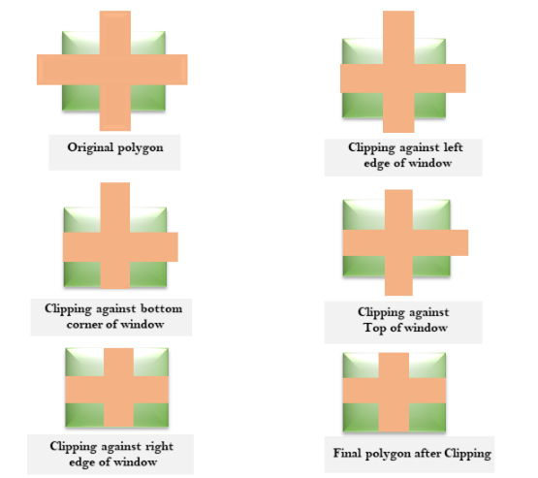

Slide 3
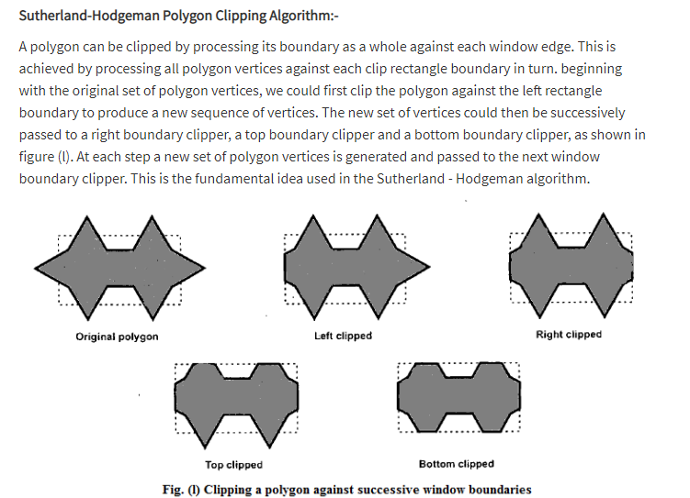

Slide 4
Processing of polygon edges against left window boundary

Slide 5
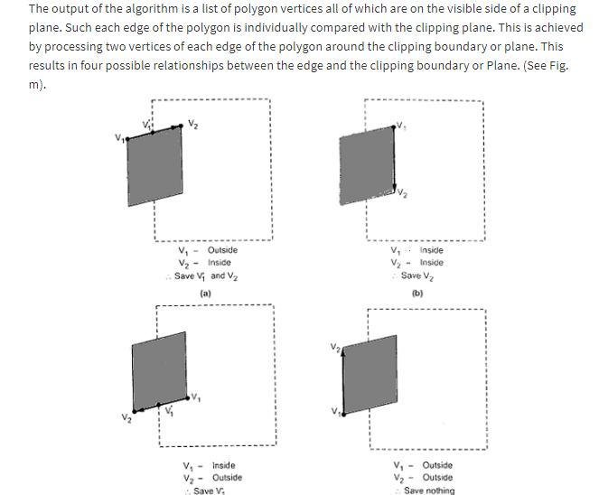

Slide 6
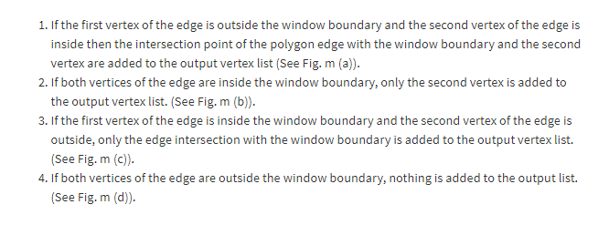

Slide 7
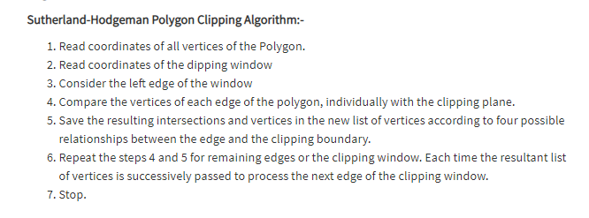

Slide 8
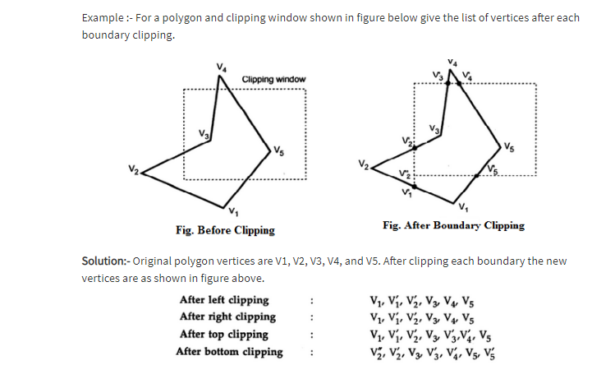

Slide 9
Video ref links
https://youtu.be/Yo2mdg-k41w

